Slide 1

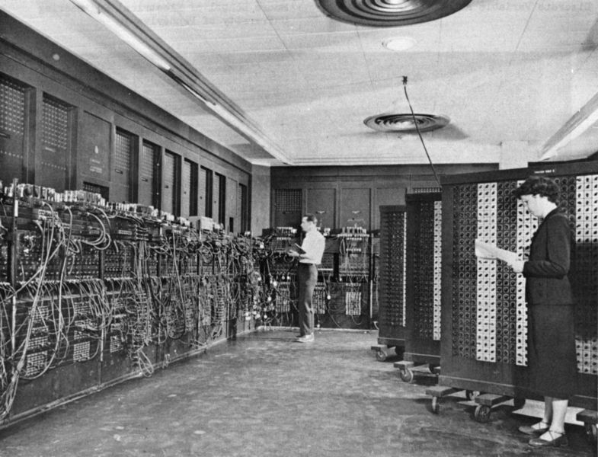
ENIAC (Electronic Numerical Integrator And Calculator)

Slide 2
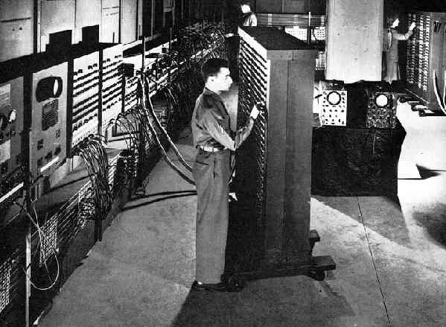
First Developed
In 1946, John Mauchly and J Presper Eckert developed the ENIAC I. The U.S. military sponsored their research; they needed a calculating device for writing artillery-firing tables (for weapon accuracy).
The Ballistic Research Laboratory, or BRL heared about John Mauchly’s research at the University of Pennsylvania's Moore School of Electrical Engineering. So in 1942 he begun designing a better calculating machine based on the work of John Atanasoff that would use vacuum tubes to speed up calculations.

Slide 3
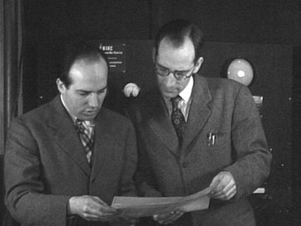
John Mauchly and J Presper Eckert
On May 31, 1943, the military commission on the new computer began; John Mauchly was the chief consultant and J Presper Eckert was the chief engineer.
It took the team about one year to design the ENIAC and 18 months and 500,000 tax dollars to build it.
By that time, the war was over. The ENIAC was still put to work by the military doing calculations for the design of a hydrogen bomb, weather prediction, cosmic-ray studies, thermal ignition, random-number studies and wind-tunnel design.

Slide 4
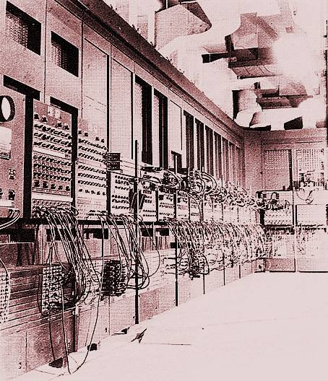
The Diameters of ENIAC
The ENIAC contained 17,468 vacuum tubes, along with 70,000 resistors, 10,000 capacitors, 1,500 relays, 6,000 manual switches and 5 million soldered joints. It covered 1800 square feet (167 square meters) of floor space, weighed 30 tons, consumed 160 kilowatts of electrical power.

Slide 5
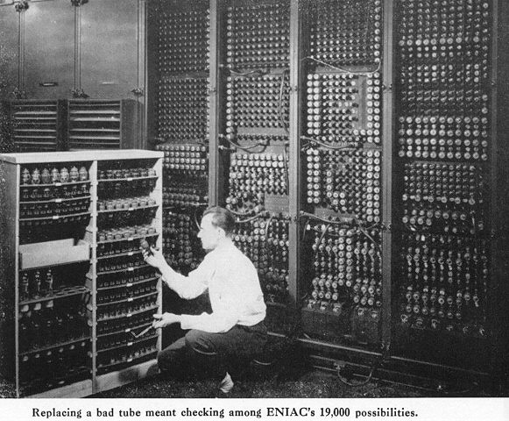
Speed of ENIAC
In one second, the ENIAC (one thousand times faster than any other calculating machine to date) could perform 5,000 additions, 357 multiplications or 38 divisions. The use of vacuum tubes instead of switches and relays created the increase in speed, but it was not a quick machine to re-program.

Slide 6
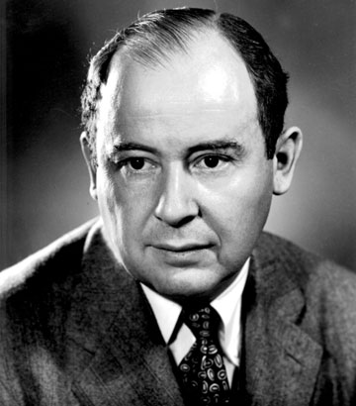
Dr. John Von Neumann
In 1948, Dr. John Von Neumann made several modifications to the ENIAC. The ENIAC had performed arithmetic and transfer operations concurrently, which caused programming difficulties. Von Neumann suggested that switches control code selection so pluggable cable connections could remain fixed. He added a converter code to enable serial operation.

Slide 7
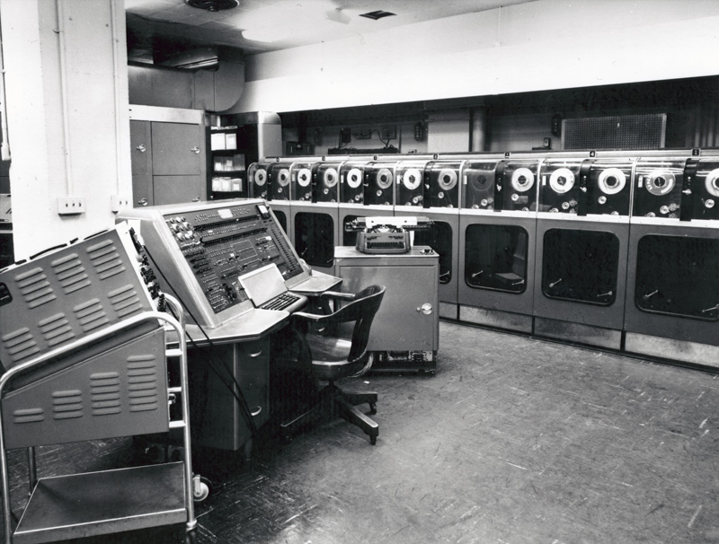
ENIAC - UNIVAC
In 1950, the Remington Rand Corporation bought the Eckert-Mauchly Computer Corporation and changed the name to the Univac Division of Remington Rand.
Their research resulted in the UNIVAC (Universal Automatic Computer), an important forerunner of today's computers.

Slide 8
Bersant Gashi 9/B

